Slide 1
Automated matching of right/left neurons
Ko2561
Kohei Ono

Slide 2
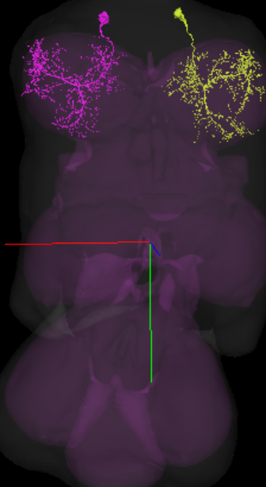
Right/left Neuron pair
•Each right/left neuron has its pair on the other side, which has the same
function, and similar is shape.
＜Advantage＞
1. Genetic efficiency (less complicated, less energy)
2. Balance in Movement …and so on…
*On the other hand, some asymmetric pairs exist for various reasons.
(Like for brains to simultaneously complete two different tasks.)

Slide 3
My first computational job at Mann Lab
・I was given ID of a pair of right/left symmetric neurons. Then, manually looked for another right/left pair in downstream neurons of that first pair.
->Then, I found codes “NBLAST”, which compares similarity of two neurons’ shapes. I wondered why this right/left matching can’t be automated.

Slide 4
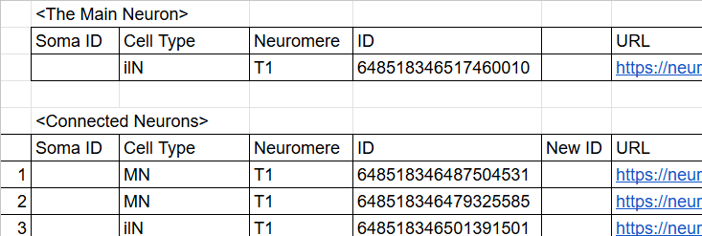
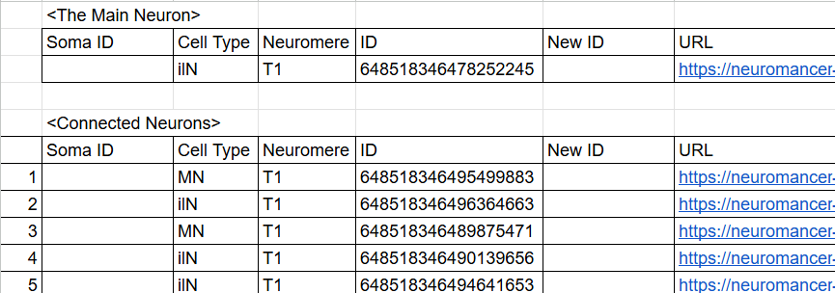

Slide 5
What my codes does
1. There’s one pair of right/left symmetric neurons
2. Download right/left “skeleton” swc files (neurons converted to set of multiple dots) of downstream neurons of that pair.
2. Flip over the right skeleton symmetically
3. Compare the similarity of two neurons by using NBLAST

Slide 6
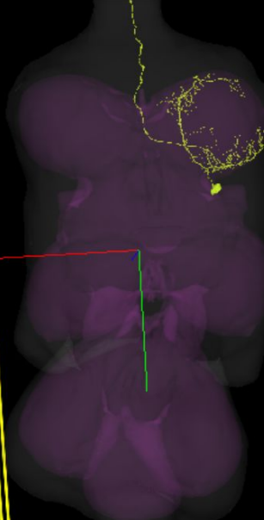
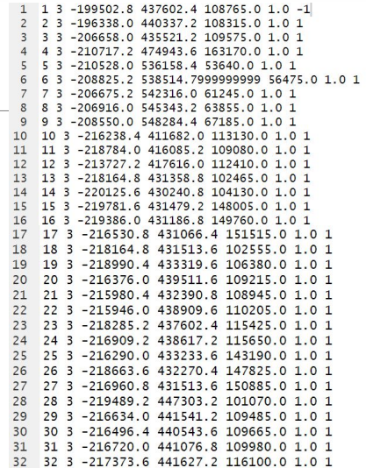
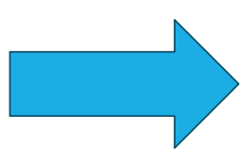

Slide 7
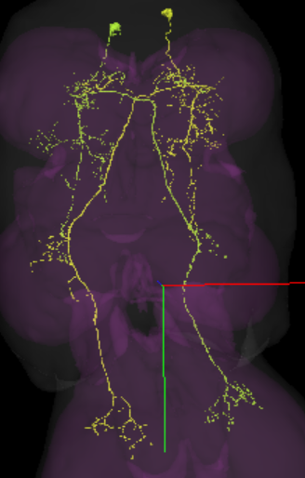
The symmetric pair I used: 648518346475464576 and 648518346488820970

Slide 8
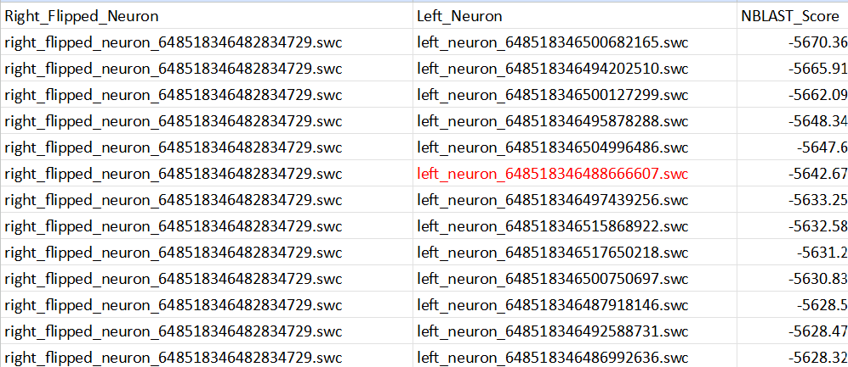
Line up according to NBLAST Score (*There’re 20 right /40 left downstream neurons.)

Slide 9
Results

Slide 10
Analysis
In short, there’s not a correlation between NBLAST score and left/right symmetric pair.
In other words, Pair matching cannot be automated by NBLAST score.

Slide 11
Reason why NBLAST Scores are not reliable
1. swc files don’t have “Parental Node” information (which dots connected to which dots.)
2. The location of neuron is not considered. (Neuron with similar shape, but different location got a higher score)
3. Neuron’s Proofreading is not perfect (True shape might be different)
・For above reasons, pair matching still has to be done manually. But I think if the accuracy of NBLAST automated matching improved, matching can be simplified. (Like looking at only top ten neurons from NBLAST scores)

Slide 12
